Slide 1



Cultivation of Nutrient-Dense Plants in Amended Mars Global Simulant (MGS-1) for Martian Use
Skylar Catania & Taylor Alger
Mentor: Lorena Caballero
Arizona NASA Space Grant Statewide Student Symposium
Scottsdale, Arizona
April 19, 2025
Notes:
https://www.earth.com/news/mars-surface-contains-more-organic-matter-than-previously-believed/

Slide 2
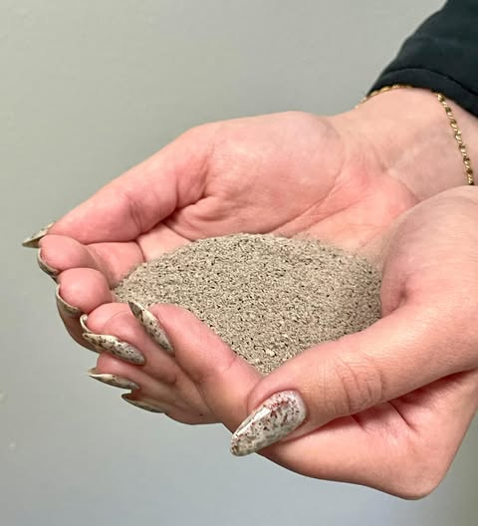
Introduction
Future Mars Missions: Food
Space is too limited for importing food and soil
Biological Life Support Systems (BLSS)

Slide 3
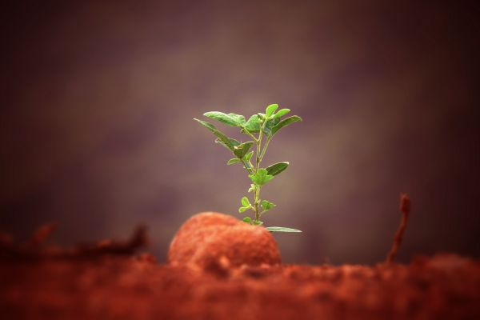
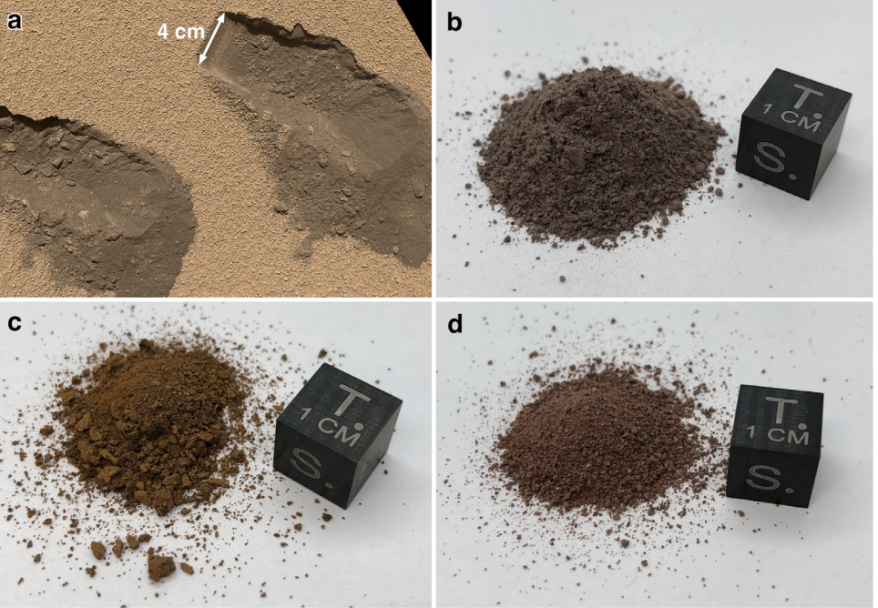
The Problem
In-Situ Resource Utilization (ISRU)
Martian Regolith lack of organic matter and the alkaline pH
Must be modified/enhanced
Regolith simulant
Source: https://www.marssociety.ca/
Source: Mars global simulant MGS-1: A Rocknest-based open standard for basaltic martian regolith simulants

Slide 4
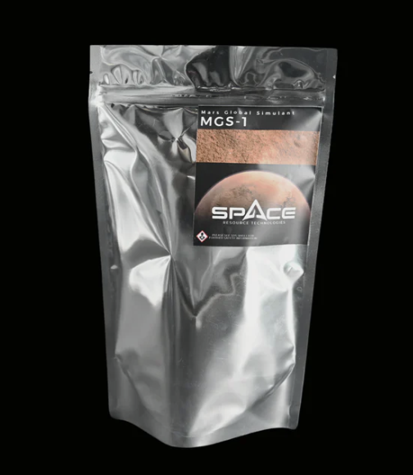
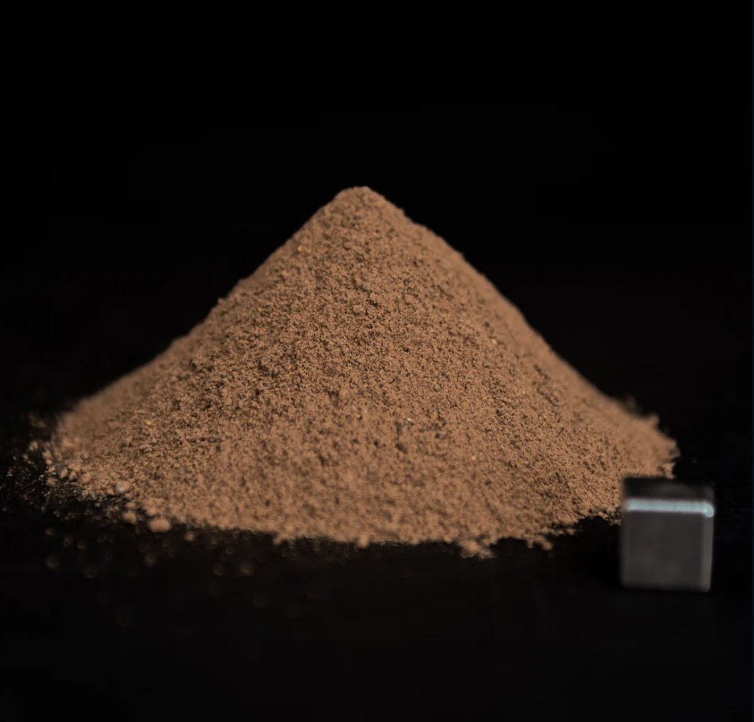

Background: Simulated Martian Regolith and Compost Amendment
Source: https://www.amazon.com/dp/B07D73V3ST
Source: https://spaceresourcetech.com/products/mgs-1-mars-global-simulant?srsltid=AfmBOop-MbJ4Fqalr6-3AcYP0wIoBWCbusn8xNuB8harGulMVt1t3Mcl
Mars Global Simulant-1 (MGS-1)
Compost Amendment

Slide 5
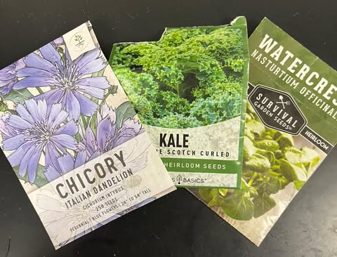
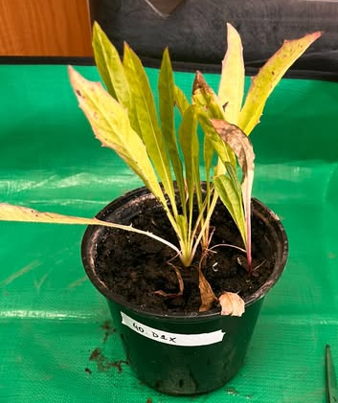
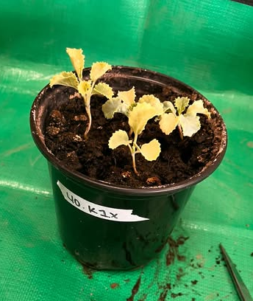
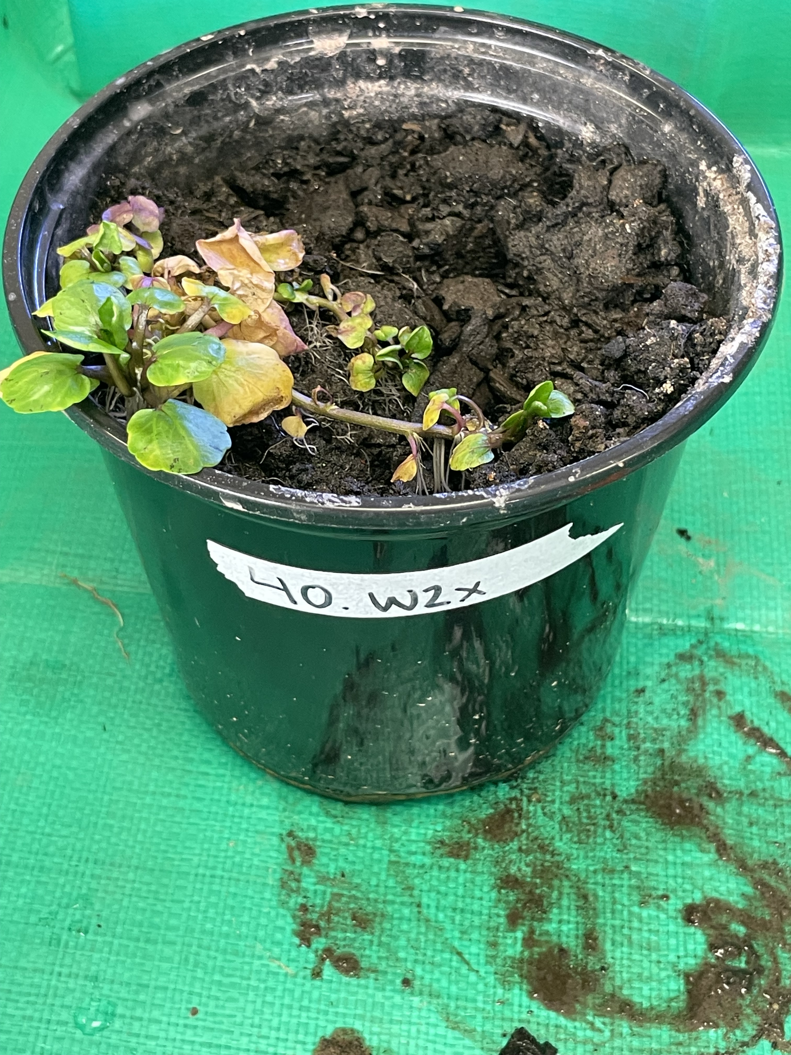
Plants
Cichorium intybus L.
(Chicory)
Brassica oleracea var. Acephala
(Kale)
Nasturtium officinale
(Watercress)

Slide 6
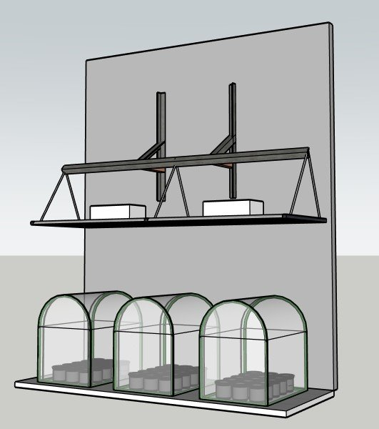
Materials & Methods
Efinity Ecogrow 630-watt LED Grow Light from Hydrobuilder
Plants segregated by species
Five seeds planted into every pot equidistant from each other

Slide 7
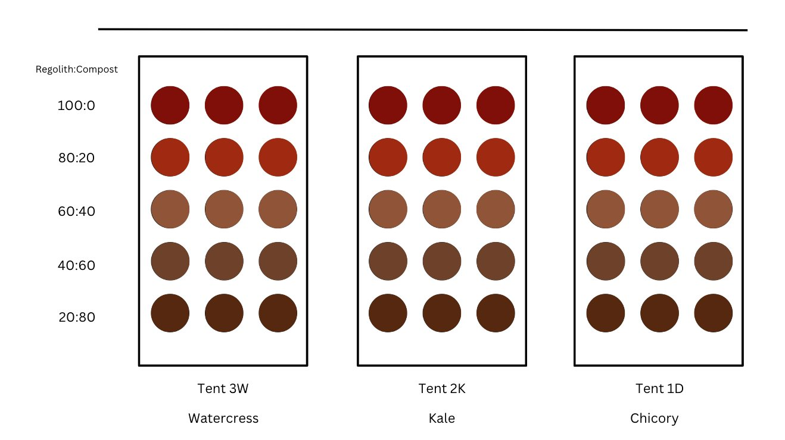
Materials & Methods
MGS-1 Martian regolith and all-purpose compost blend in the ratios: 100:0, 80:20, 60:40, 40:60, and 20:80

Slide 8
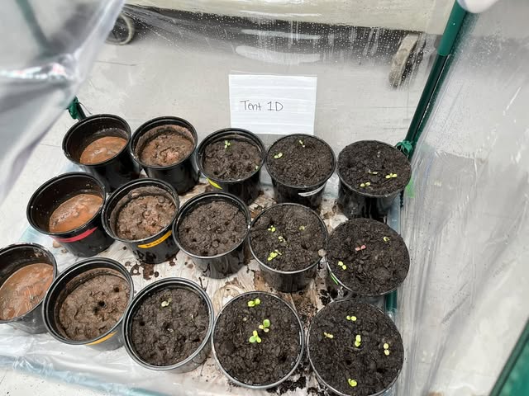
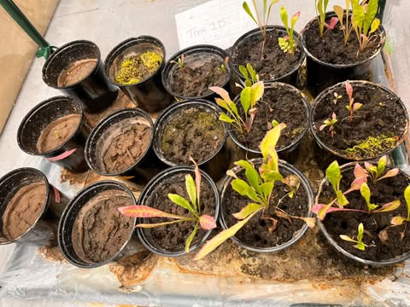
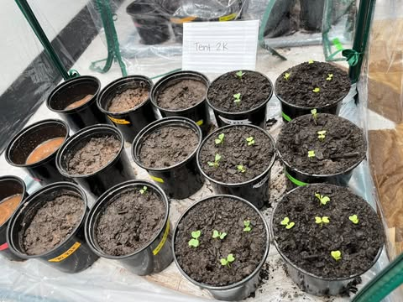
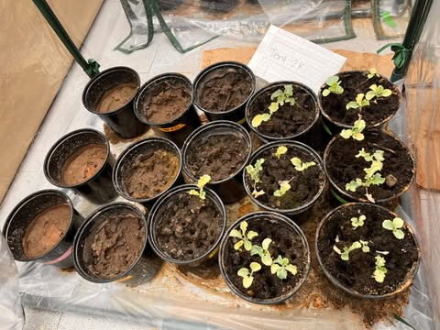
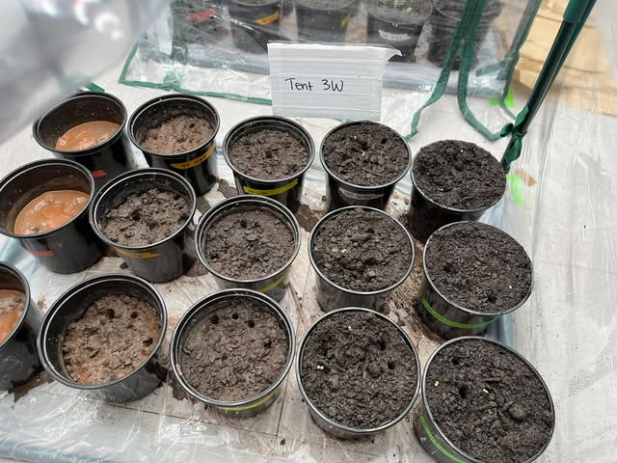
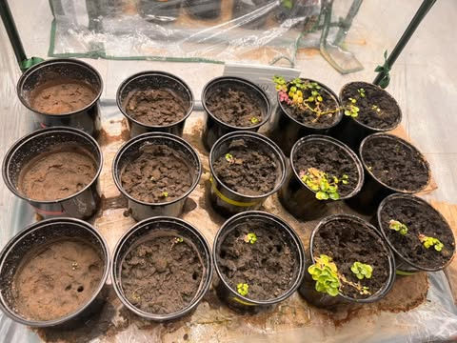
Materials & Methods
Daily data collection
pH
Temperature
Humidity
Light Intensity

Slide 9
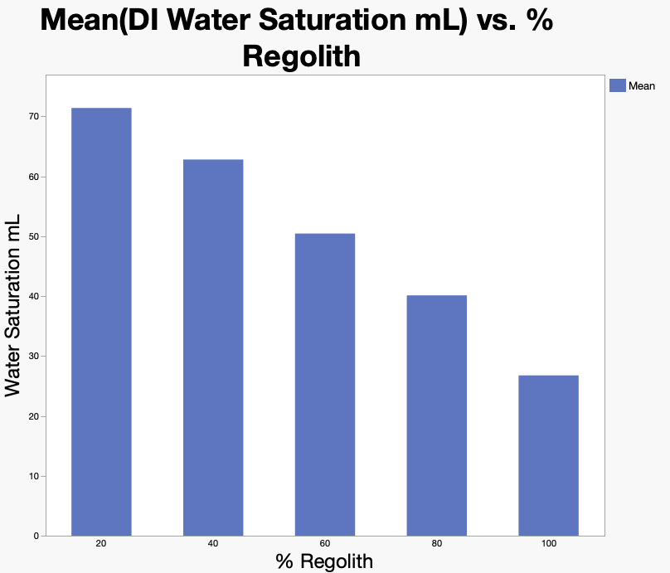
Materials & Methods
Figure 1. Mean Saturation Water mL by Regolith Percentage

Slide 10
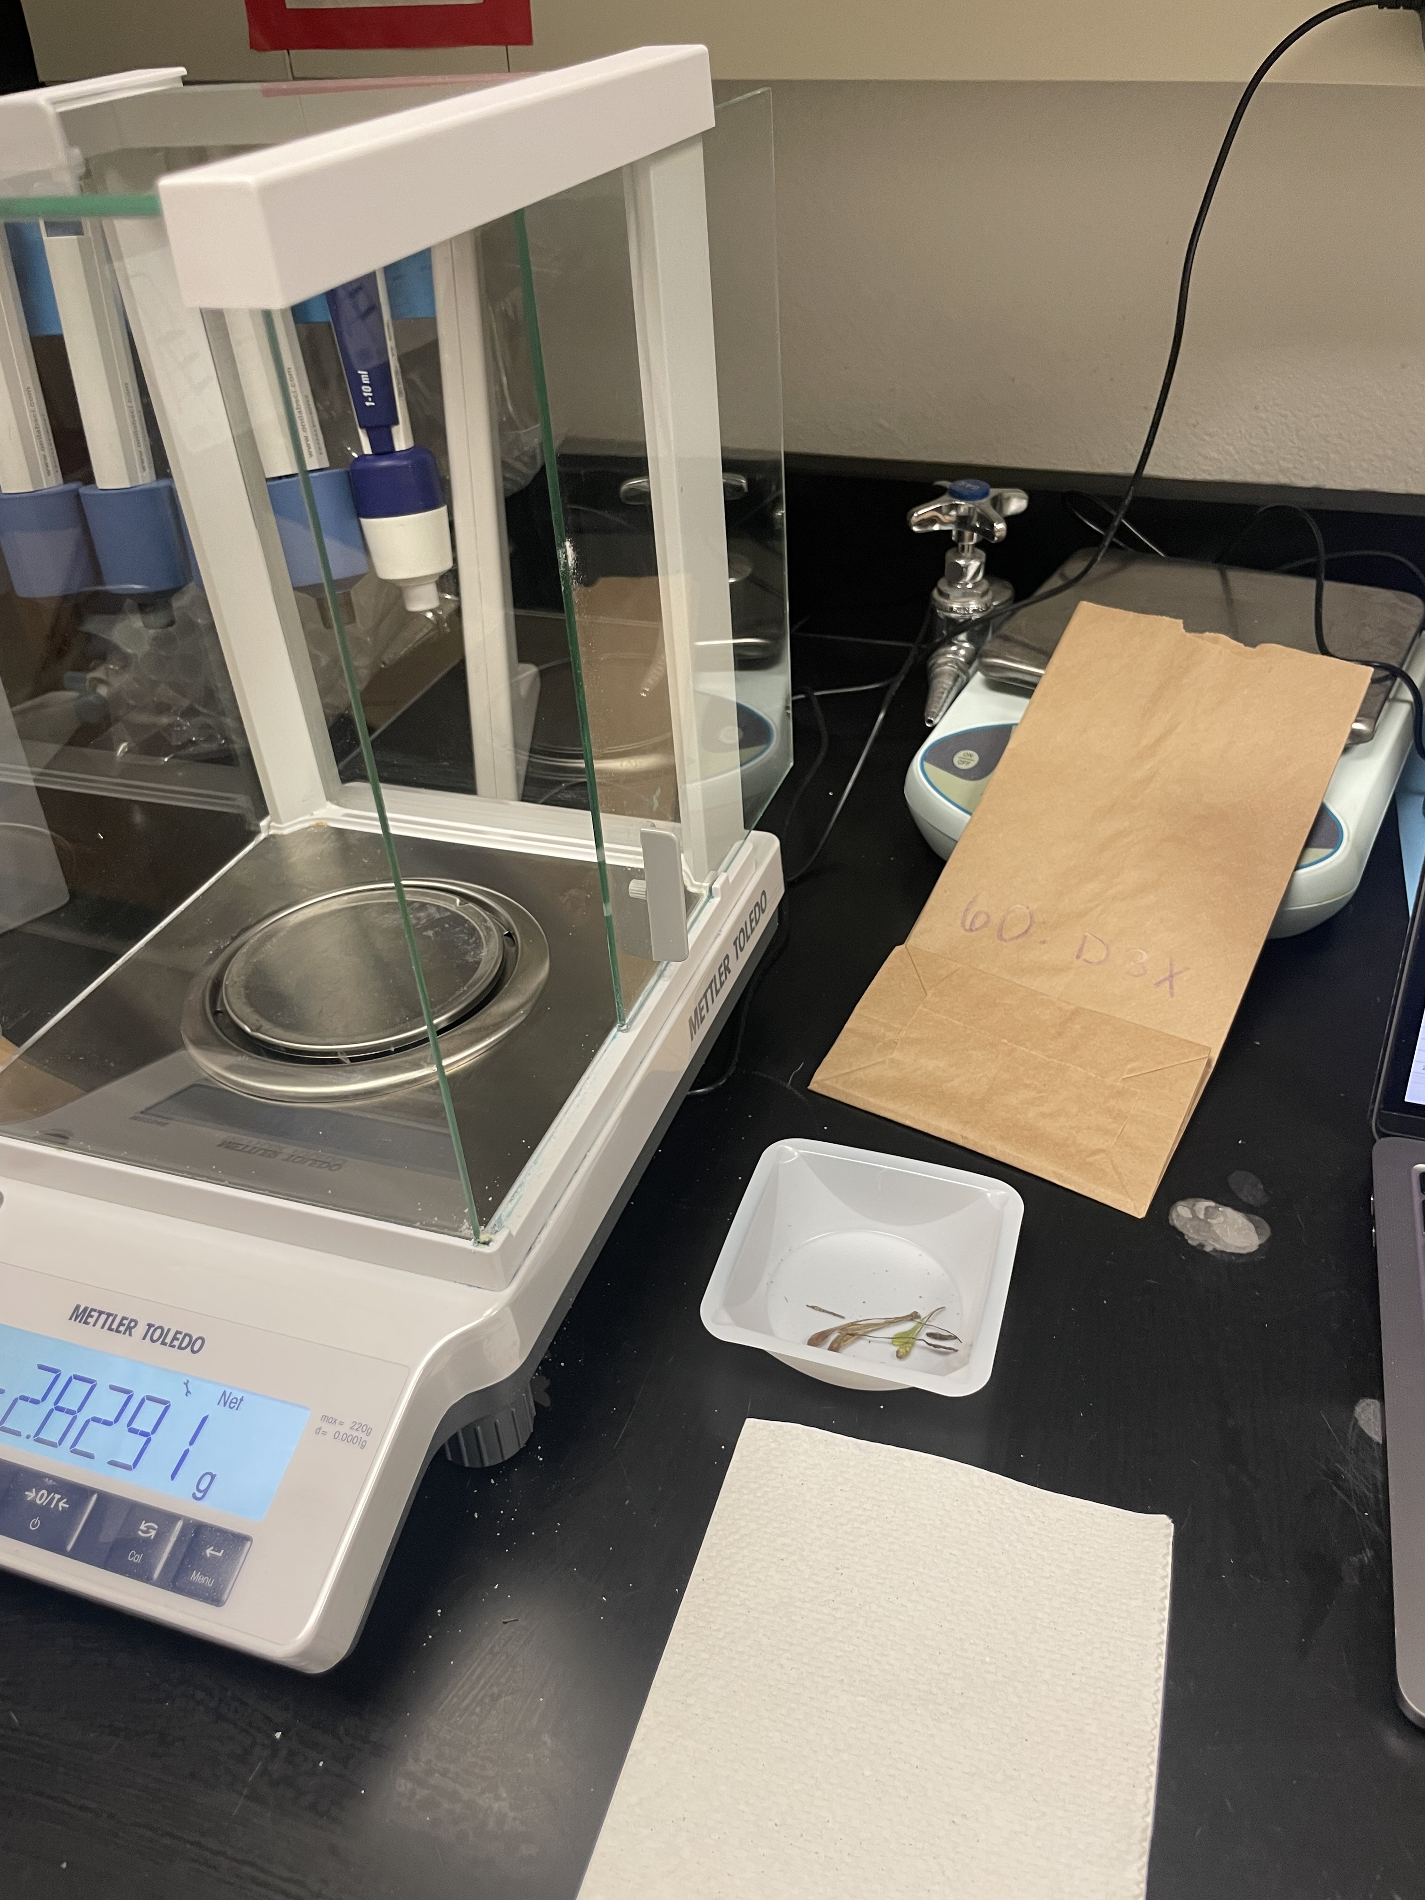
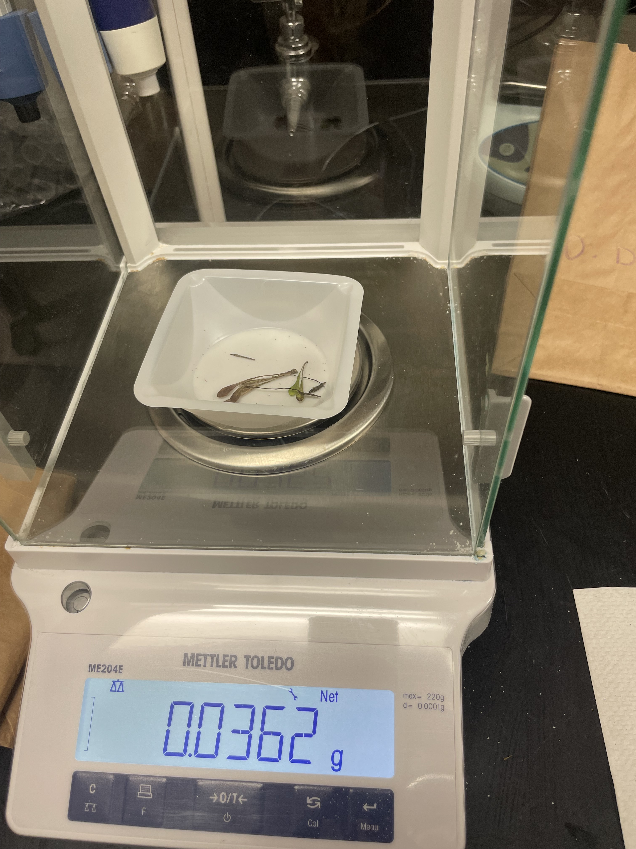
Materials & Methods
Harvesting and Processing
Clipped Plants at the soil surface
Desiccated all plant biomass
Recorded dry mass

Slide 11
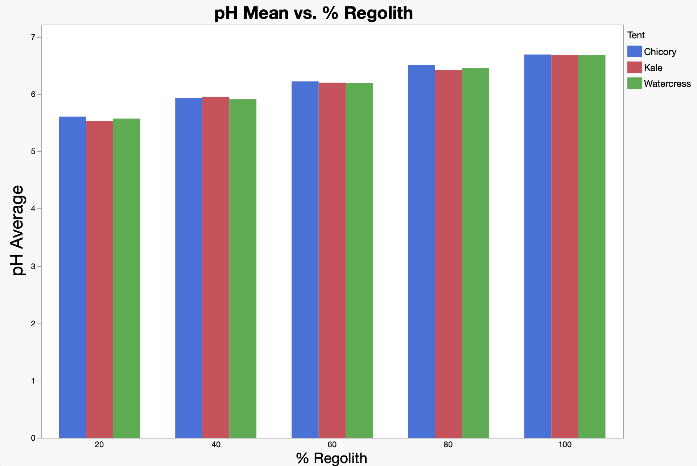
Results
Figure 2. pH of Growth Media by Regolith Percentage

Slide 12
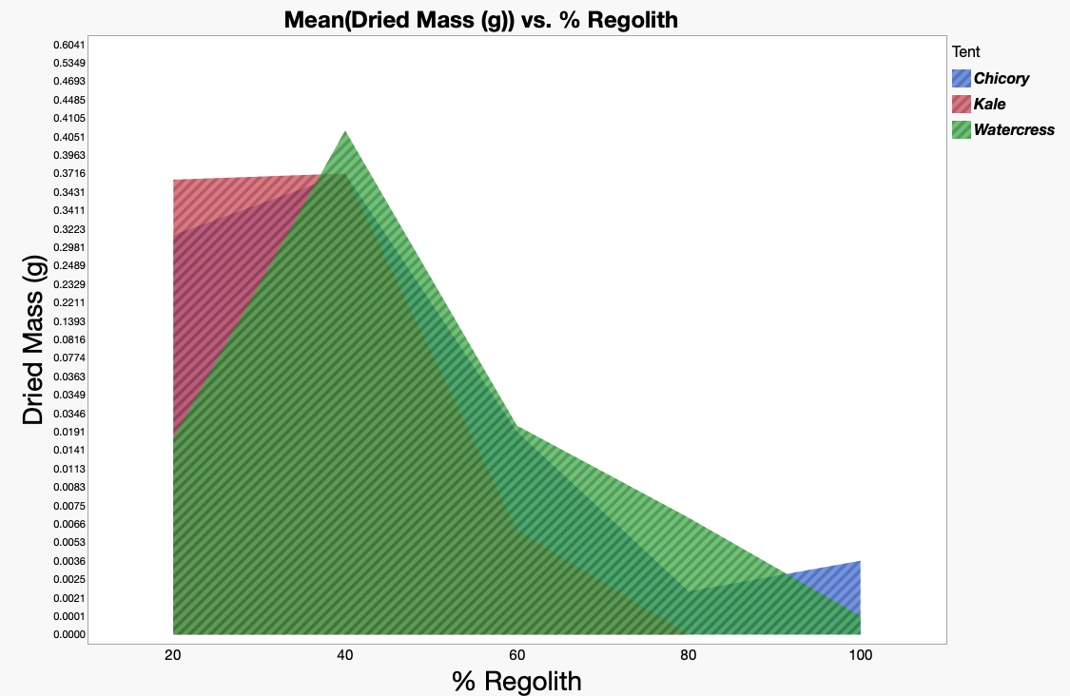
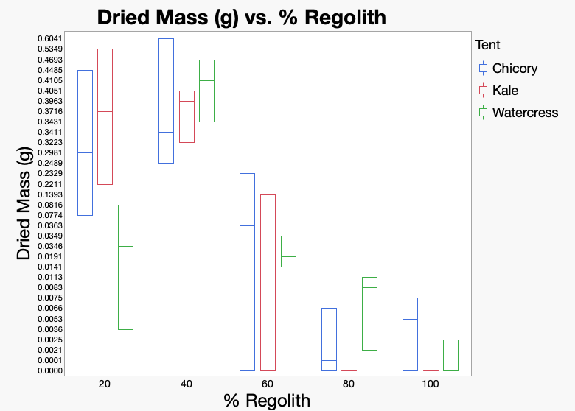
Results
Figure 3. Dried biomass by Plant Species and Percent Regolith
Figure 4. Boxplot of Dried Biomass Across All Plant Species by Percent Regolith

Slide 13
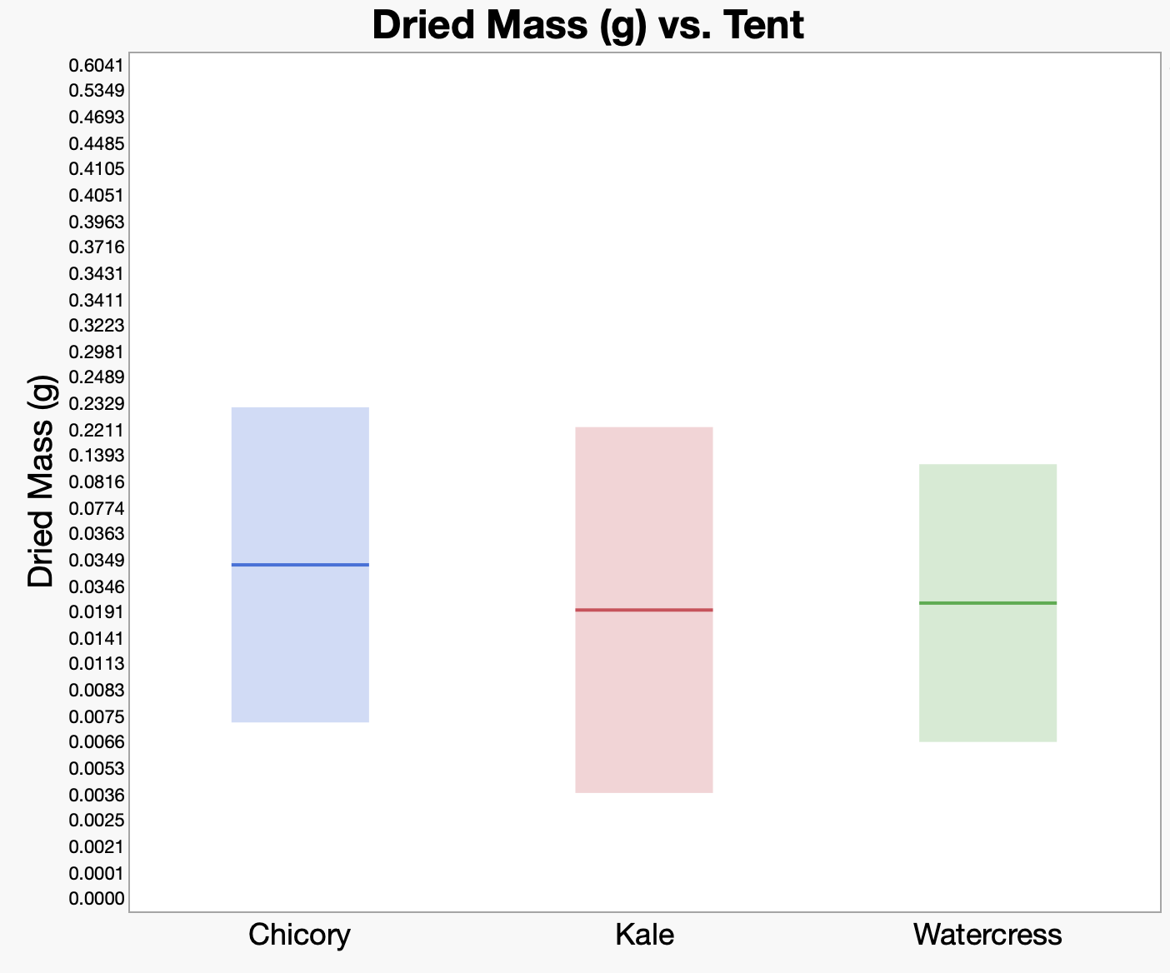
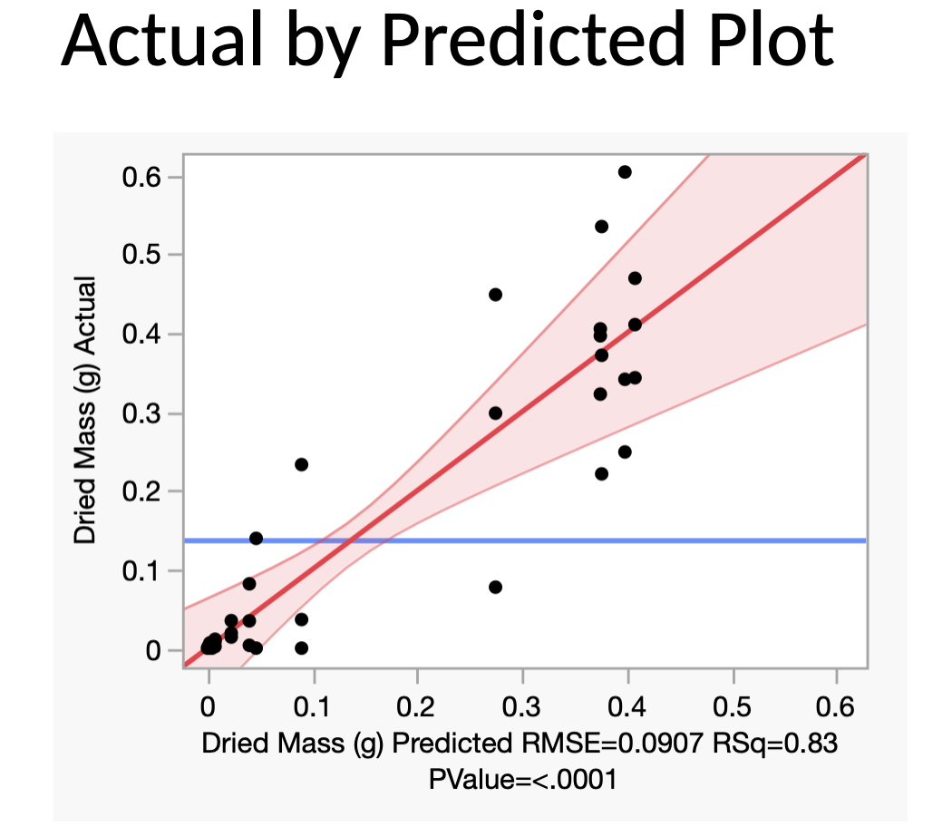
Results
Figure 5. Boxplot of Dried Biomass by Plant Species
Figure 6. Dried Mass Actual by Predicted

Slide 14
Conclusion & Next Steps
Martian regolith can be successfully amended for better crop yield
Future Research on this topic
Growing soil amendment with alfalfa (Medicago sativa) in 100% regolith
Comparing water volume needs for different plants
Testing different compost compositions to optimize nutrient availability

Slide 15

Acknowledgments
Northern Arizona University, Arizona Space Grant
Mentor:
Lorena Caballero
Volunteers:
Nicole Compese
Paloma Davidson
Sarah Emmett
Jordan Fitzgerald
Helene Larson
Katie Puckett

Slide 16
Thank you!

